Slide 1




Amazon Sales Analysis Report

Slide 2
Problem Statement:
Amazon is the most leading E-Commerce company
Amazon-Sales management has gained importance to meet increasing competition and the need for improved methods of distribution to reduce cost and to increase profits

Slide 3
Main KPIs
By analyzing
the Sales dataset
we get Those
Insides Let's move step by step
Units Sold
Total Profit
Total Cost
Date
Item Type
Region

Slide 4

Key Inside
At 27160, Sub-Saharan Africa had the highest Sales and was 318.55% higher than Middle East and North Africa, which had the lowest Sales at 6489.
Sub-Saharan Africa accounted for 29.40% of Sales.
Across all 5 Region, Sum of Sales ranged from 6489 to 27160.
Total Sales trended down, resulting in a 20.05% decrease between 2010 and 2017.
Sales started trending down from 2012, falling by 49.75% (48741) in 5 years.

Slide 5
Key Inside
The most recent anomaly was in May 2017, when Total Sales had a high value of 16880.
Sales had the most significant anomaly, a high of 22646 on July 2012.
Sales experienced the longest period of decline (-5400) between February 2010 and December 2010.
Total Cost was higher for Offline (10840.7) than Online (8263).
Sub-Saharan Africa in Sales Channel Offline made up 25.81% of Sum of Unit Cost.
Sales dropped from 97967 to 49226 during its steepest decline between 2012 and 2017.
Sales Sold had several high anomalies between November 2011 and May 2017

Slide 6
Key Inside
At 24655796.30, Office Supplies had the highest Cost and was 7,026.24% higher than Fruits, which had the lowest Cost at 345986.
Sum of Total Cost and total Sum of Total Profit are positively correlated with each other. (Not highly positive correlation)
Office Supplies accounted for 26.46% of Sum of Total Cost.
Sum of Total Cost and Sum of Total Profit diverged the most when the Item Type was Office Supplies, when Sum of Total Cost were 18726212.5 higher than Sum of Total Profit.

Slide 7



My Design

Slide 8


Slide 10

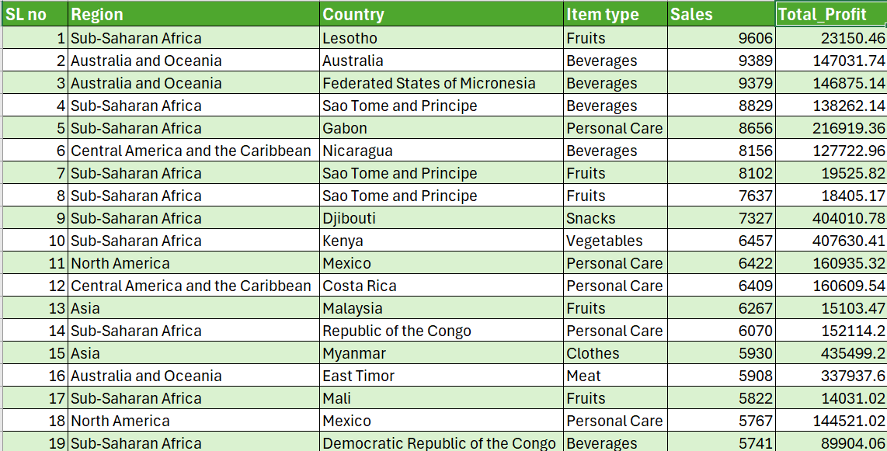
Let's have a quick look over the data set to find the reason behind "not highly positive correlation between sales and profit"
Here are Country, Region and Item type wise 19 data record where sales is higher but not get that much profit according to Seles

Slide 11
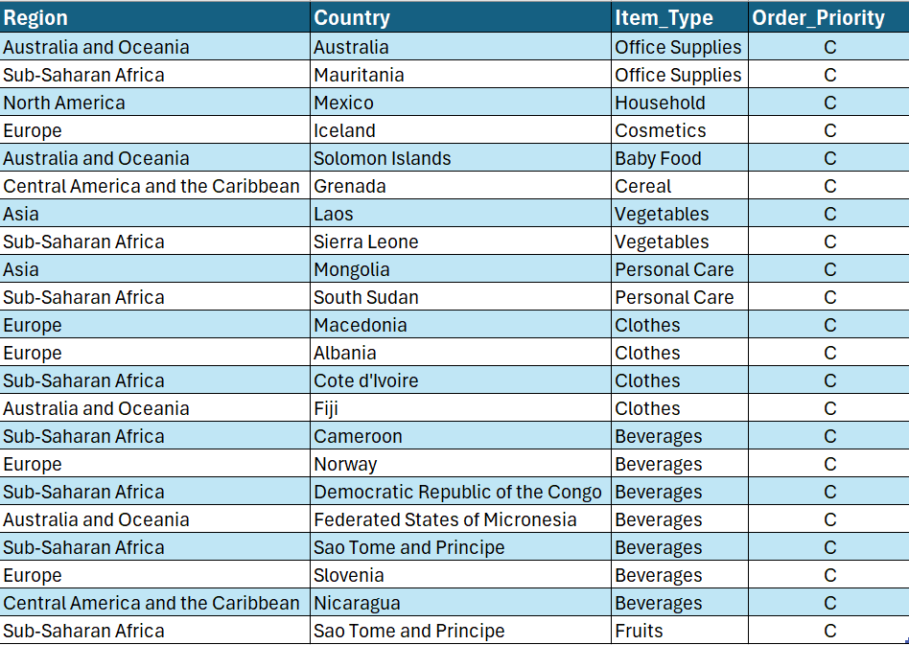
Let's Deep drive on to key driver of downward Trend
This is a clear view of “C” group data from order priority
As “C” group of order priority is highly responsible for downward sales trend

